Slide 1


Denarri
The Products You Love, At The Price You Want, In 3 clicks.
Andrew Ghobrial | aghobrial@denarri.com

Slide 2



The Current State Of M-Commerce
Not Personalized
Out Of The Loop
Overchoice Paralysis
Because user preferences aren’t learned/used effectively, the avg. mobile shopping search takes 6 steps.
Push notifications aren't timely, relevant, or actionable enough, resulting in only 47% of users opting in, and only 11% engaging with them.
Users are forced to sift through thousands of results on a daily basis until the right match is found, increasing the probability they’ll abandon the purchase by up to 10x

Slide 3



The Mobile Marketplace Done Right
Denarri helps users get the best price on the products they love in 3 clicks by learning their shopping habits. It’s designed to become faster and more intelligent the more a user shops.
Personalization Engine
Item Priority Ranking
Curated
Learns your preferences and uses it to predict your criteria when searching for an item. This cuts the avg. # of steps in half to 3.
Based on the priority level of the item, Denarri determines the optimal notification frequency and seller location. Never miss out on the perfect match.
The MatchCenter intelligently curates the best matches for every item you follow, all in one place.

Slide 4




Metrics
Growth
Userbase
Engagement
Retention
67% MoM growth the past 3 months (2/15-4/15)
1.5k MAU (As of 4/25/2015)
95% push notification opt in, industry avg. is 47%. 24% push notification engagement, industry avg. is 11%
MAU/Total User rate of 49%.

Slide 5
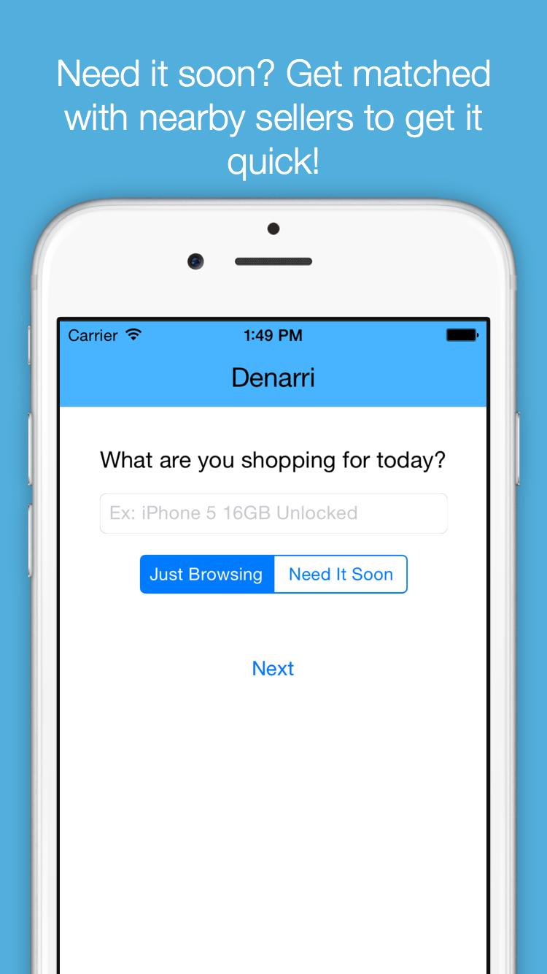
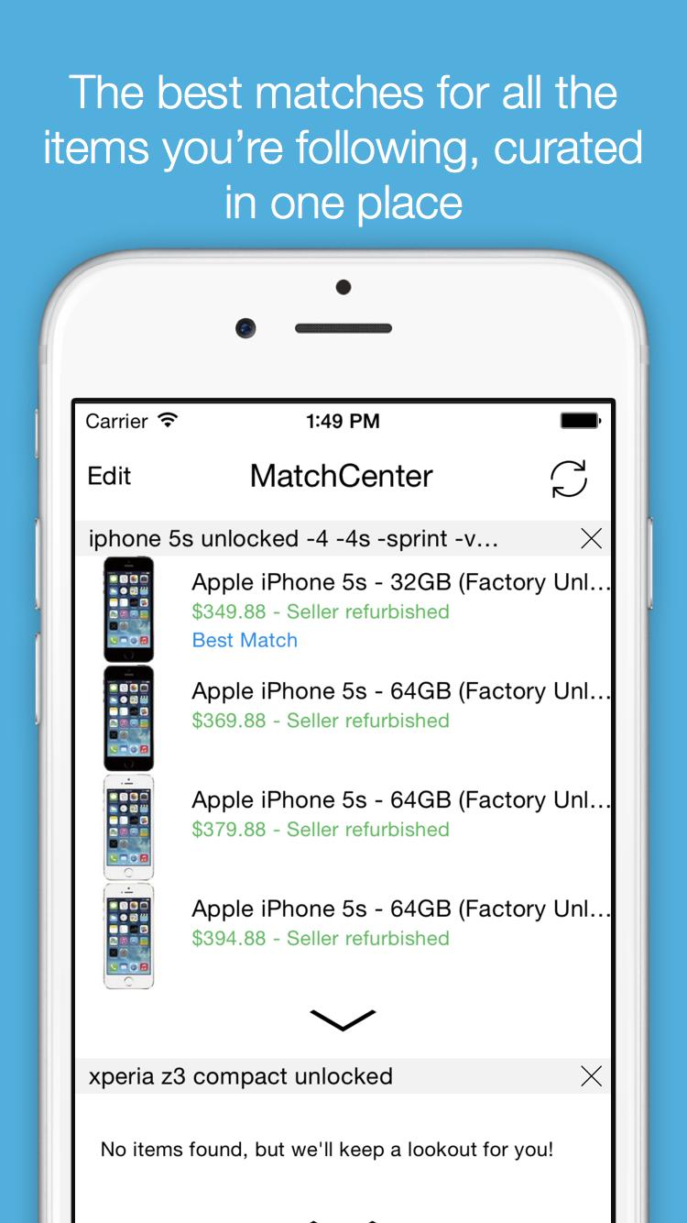
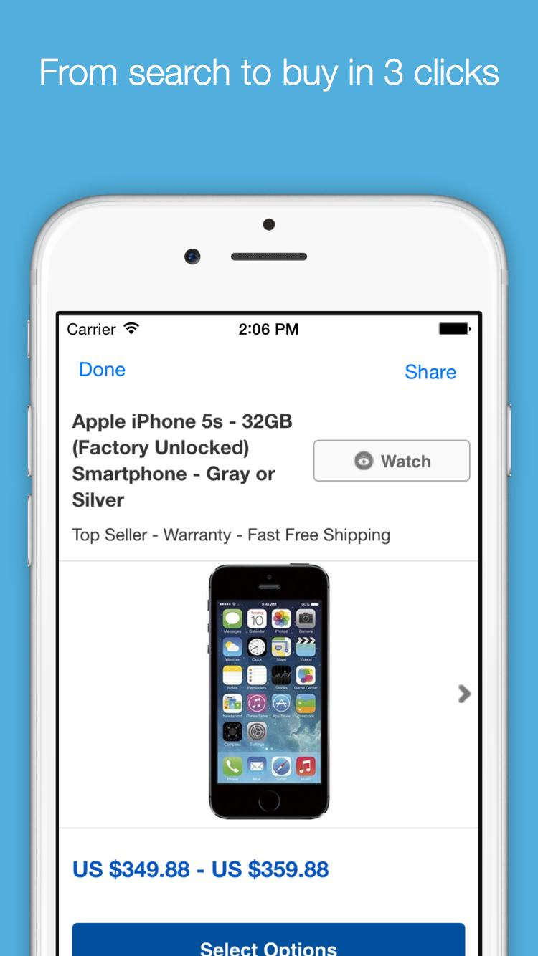
Example UX Scenario
Denarri predicts they want it New, $300-450, and ships within 3 days, no user input required. Best matches are curated.
User receives a notification of a better match found and makes the purchase in one click.
User searches for “iPhone 6 32GB”

Slide 6



Upcoming User Experience
User searches for “Blue Uniqlo button down”
“Since you’re a male and size S in J.Crew, here are Men’s Uniqlo button downs with the same fit and price range you like”. Again, no user input required, the most frictionless experience.
User finds the perfect match and purchases in one click, confident they got the best deal and the right fit.

Slide 7

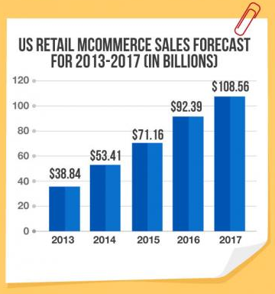
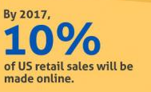
Why Now?
No device knows a user better than the one always in their pocket.
The marketplace that most effectively utilizes user preferences stands to capture the largest % of the rapidly growing m-commerce industry.

Slide 8
Revenue Model
A transaction fee of 5% of final sale price.
$2,466
100,000
$1.23M
Average yearly ecommerce spending
2015 user base goal
Year 1 revenue (assuming 10% of online purchases made through Denarri)

Slide 9




Reaching Marketplace Liquidity
Phase I (Current)
Phase II
Phase III
+
+
+
?
Introduce selling functionality, and slowly phase out 3rd parties as selection grows.
Denarri now a full fledged marketplace, form partnerships with Shyp/Shipster to automate shipping logistics for sellers without the need for fulfillment centers.
Piggyback off existing marketplaces’ selection to build buyer-side user base.

Slide 10



Distribution
Share
Refer
Community
Sharing deals with friends/family is built into the user flow, and links back to the app when clicked.
Users will be rewarded for every new user they refer when that user makes their first purchase, creating viral loop.
Denarri team is heavily ingrained in deal-finding and seller communities on and offline. This was a large driver behind Etsy’s initial growth.

Slide 11




The Competition
Intuitive Shopping Experience
B & M
Higher Prices
Lowest Prices
Clunky Shopping Experience

Slide 12
Competitive Advantages
More Relevant
Smarter
Item Priority Ranking resulted in >95% of users opting in to notifications, with 24% engaging with pushes, compared to the industry avg. of 11%.
Personalization Engine predicts your preferences, so match curation becomes more accurate over time.
Easier
Faster
Combines the personalization and intuitiveness of B&M with the convenience and price advantages of online.
What takes at least 6 steps (causing shopping cart abandonment) in the typical shopping experience is accomplished in 3 on Denarri.

Slide 13



Global Impact
Denarri will create a new breed of merchants due to 3 selling advantages:
Simplified Selling
Level Playing Field
Seller Protections
Search result ranks places more emphasis on individual buyer preferences, not seller size, giving new sellers a level playing field.
5% transaction fee means sellers keep more of the profit and are able to charge lower prices.
Shipping logistics will be handled by partners like Shyp.
Turnover is faster due to instant buyer notifications when listed.
Item listing takes 3 clicks, and sellers can import their inventory from other marketplaces.
Buyers and sellers are equally important to the ecosystem.
Denarri won’t default to siding with the buyer like the incumbents, resulting in less fraud/abuse on both sides and a happier userbase.

Slide 14



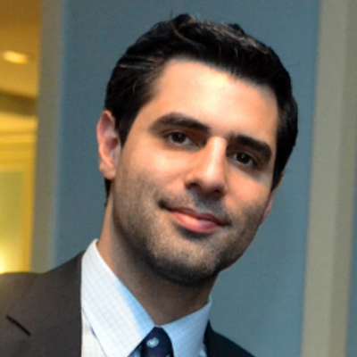







Why Me?
Mentors with deep industry knowledge
Andrew Ghobrial
Founder & CEO
13 years experience as an eCommerce merchant, starting at age 10.
Matt Hamilton
Paul Kist
Ilia Papas
Brian Wang
Development
Design
Growth
Product Manager
Lead Engineer
Founder & CTO
Founder & CEO

Slide 15
Ask
Raising
Runway
Use
Amount: $500,000
Pre-money valuation: $3mm
Type: Equity
18 Months
Hire full time backend and iOS developers.
Implement selling functionality, ramping up revenue stream
User acquisition through referral rewards

Slide 16
Denarri
The Products You Love, At The Price You Want, In 3 clicks.
Andrew Ghobrial | aghobrial@denarri.com

